Slide 1

Exploring Toronto Neighbourhood COVID-19 Rates and Venue Types

Slide 2
Introduction
Over the course of the past year, COVID-19 has upended the lives and livelihoods of billions. In an effort to contain the spread and limit the strain placed on healthcare systems, many governments have engaged in “lockdowns” of varied methodology and severity. One such methodology has been lockdowns based on the forced closure (or limiting capacity) of businesses/venues based on the category the business/venue falls under, and the perceived risk of COVID-19 transmission for that business/venue category. This typically has significant implications for business owners in the form of lost revenues, employees in the form of lost income, taxpayers in the form of increased welfare burden, and the public in the form of lost freedom.
In many cases, for varying reasons,it has been difficult for decision makers to develop and offer a data-based methodology to explain the rationality behind lockdowns affecting businesses and venues. This report attempts to develop a framework through which a methodology can be created to solve this problem.

Slide 3
Data
We will use data sourced from:
Scraping of Toronto Postal Code data from Wikipedia
Foursquare venue data for Toronto, accessed through their API
COVID-19 rates for neighbourhoods in Toronto, sourced from ICES

Slide 4
Methodology
Once we had retrieved the venue data using the Foursquare API, we set about grouping the venue types. The resulting venue group types were Hospital, Church, Restaurants, Fast Food, Retail, Indoor Rec, Outdoor Rec, Licensed Establishment, Personal Services, Travel, Indoor Venues, Commercial, and Essential Retail. Churches and Hospitals could potentially have been mapped to indoor venues, however due to Churches (places of worship in general) often being treated as their own category during lockdowns and the essential nature of Hospitals in the COVID-19 pandemic, we have elected to have these venues be their own distinct venue categories.
Once we had grouped venues according to the above methodology, we set about clustering postal codes by their positivity rate. This was achieved using the K-Means Clustering algorithm. We iterated over many values of K, and using the elbow method arrived at an optimal value of K = 4.

Slide 5
Methodology Cont’d
A WordCloud was created for each positivity rate cluster, in an attempt to visualize the effect venues have on COVID-19 transmission. The word cloud contains the venue groups ranked by their relative presence in the cluster.
Finally, a correlation matrix was produced for the entire city so that we could explore the correlation between positivity rates and venue types.

Slide 6
Results
K-Means Clustering for postal codes resulted in clusters with the following (median) positivity rate ranges:
Cluster 1 3.12% - 4.05%
Cluster 2 0%
Cluster 3 4.42% - 5.37%
Cluster 4 1.92% - 2.985%

Slide 7
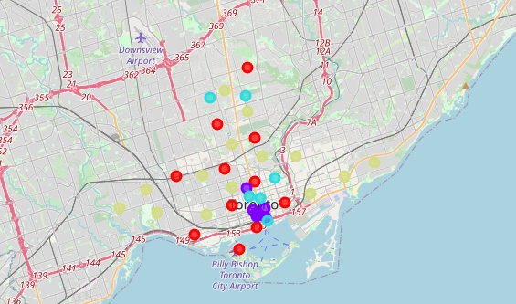
Toronto Cluster Map
Red: Cluster 1, Purple: Cluster 2, Blue: Cluster 3, Yellow: Cluster 4

Slide 8
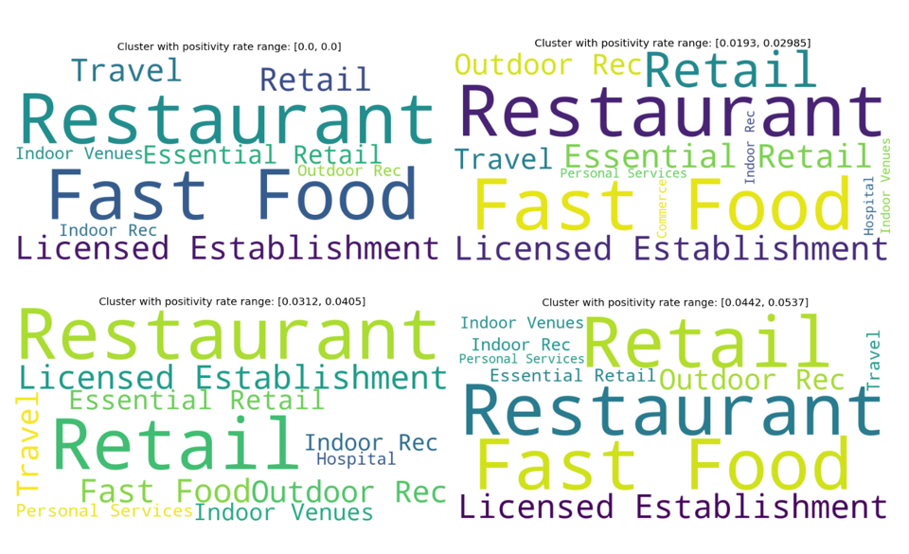

Slide 9
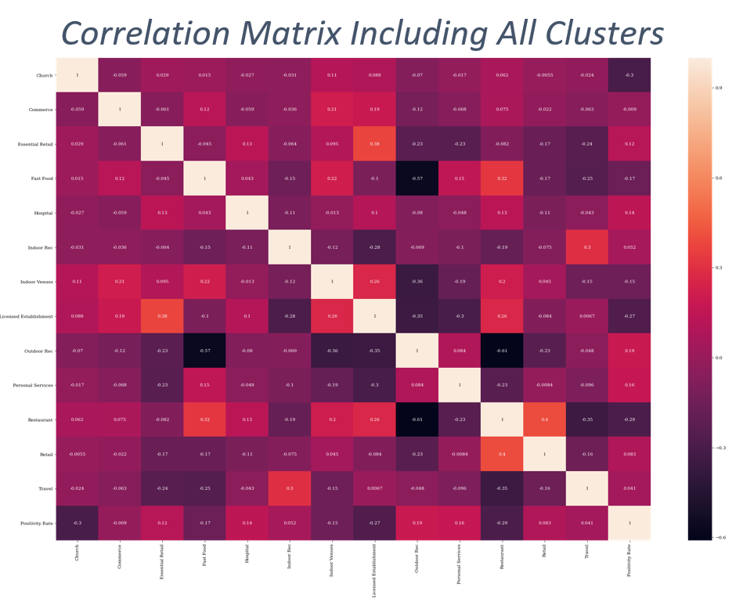

Slide 10
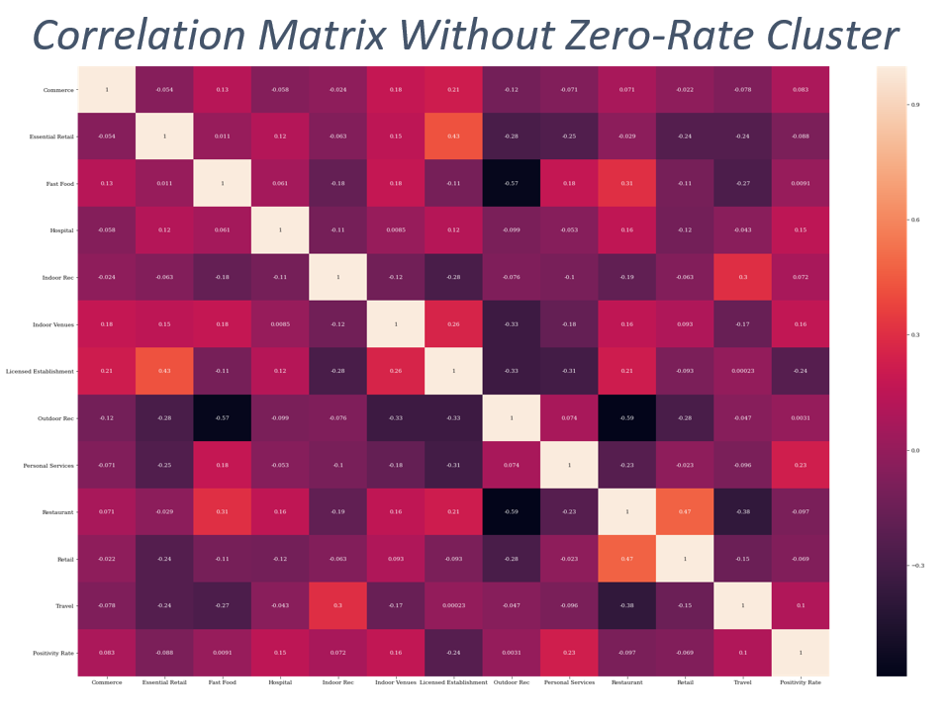

Slide 11
Discussion
The correlation matrices can be interpreted as follows; a positive value indicates that a higher presence of that venue type in an area contributes to the spread of COVID-19 in that area; a negative value indicates the opposite, that increased presence of the venue reduces the spread of COVID-19 in that area. The magnitude of the value indicates the magnitude of the effect.
Looking at the results of the correlation matrices, we find results that are unsurprising as well as ones which appear very surprising.
The relative presence of commerce, fast food, indoor rec, outdoor rec, personal services, and travel venues as well as indoor venues and hospitals appear to have positive correlation with COVID-19 positivity rates in that area.
The relative presence of Essential Retail, Licensed Establishments, Restaurants, and Retail venues appear to have a negative correlation with COVID-19 positivity rates in that area.
The effects of these venues may be the result of substitution to or from other venue types, clientele differences between venues as the result of demographics, or socioeconomic factors.

Slide 12
Conclusion
In this report we have created a framework which can be built upon and modified to determine the effect of different venue types on the spread of COVID-19.
Some our results are expected, and others are rather unexpected. Further modeling and analysis is required in order to challenge and improve these results.
Further analysis could include data and relevant modeling for the effect of socioeconomic and demographic factors, as well as time series data regarding restrictions placed on venue types.

